Slide 1
CHAPTER 1 What Is Strategy and Why Is It Important?

Slide 2
LEARNING OBJECTIVES
THIS CHAPTER WILL HELP YOU UNDERSTAND:
What we mean by a company’s strategy
The concept of a sustainable competitive advantage
The five most basic strategic approaches for setting a firm apart from rivals and winning a sustainable competitive advantage
That a firm’s strategy tends to evolve because of changing circumstances and ongoing efforts by management to improve the strategy
Why it is important for a firm to have a viable business model that outlines the firm’s customer value proposition and its profit formula
The three tests of a winning strategy

Slide 3
CORE CONCEPT (1 of 4)
A company’s strategy is the set of actions that its managers take to outperform the company’s competitors and achieve superior profitability.

Slide 4
WHAT DO WE MEAN BY STRATEGY?
What is our present situation?
Business environment and industry conditions
Firm’s financial and competitive capabilities
Where do we want to go from here?
Creating a vision for the firm’s future direction
How are we going to get there?
By crafting an action plan that heads the firm in the direction of its intended market position, attracts customers, achieves financial and market performance targets, and gets it where it wants to go—that is, its strategy

Slide 5
WHAT IS STRATEGY ABOUT?
Strategy is all about How:
How to position the firm in the marketplace
How to attract customers
How to compete against rivals
How to achieve the firm’s performance targets
How to capitalize on opportunities to grow the business
How to respond to changing economic and market conditions

Slide 6
STRATEGIC MANAGEMENT PRINCIPLE (1 of 3)
Strategy as a choice
Is about deciding to compete differently from rivals—doing what competitors do not do or, even better, doing what they cannot do!
Is likely to be successful when its actions, business approaches, and competitive moves appeal to buyers in ways that
Set a company apart from its rivals
Stake out a market position that is not crowded with strong competitors

Slide 7
STRATEGY AND COMPETITORS
Strategy is about competing differently from rivals.
Doing what they do not do or doing it better
Doing what they cannot do
Doing things that attract customers and set a firm apart from its rivals
Doing things calculated to produce a competitive edge over rivals
Doing what the firm must do and also knowing what it must not do

Slide 8
WHY BOTHER WITH STRATEGY?
A firm needs a strategy to specify what actions will be taken.
To improve its financial performance
To strengthen its competitive position
To gain a sustainable competitive advantage over its market rivals
A creative, distinctive strategy
Helps produce above-average profits
Increases competitive pressures on rivals

Slide 9
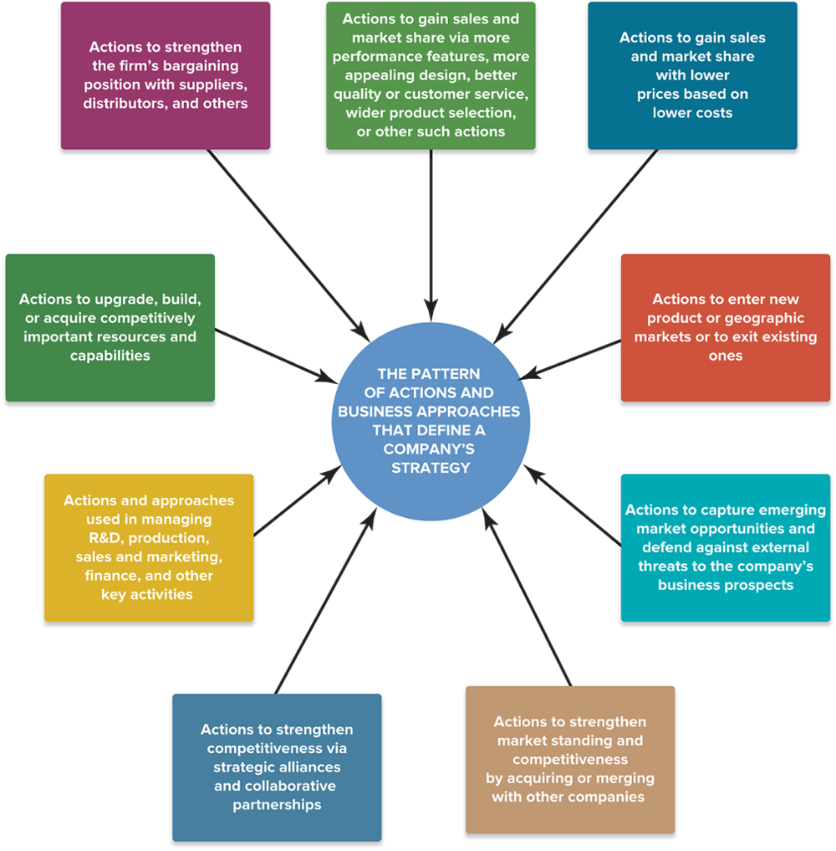
FIGURE 1.1 Identifying a Company’s Strategy–What To Look For
Jump to Appendix 1 long image description

Slide 10
Starbucks’s Strategy in the Coffeehouse Market
Key elements of Starbucks’ strategy:
Train baristas to serve a wide variety of specialty coffee drinks that satisfy individual customer preferences in a customized way
Emphasize store ambience and elevation of the customer experience at Starbucks stores
Purchase and roast only top-quality coffee beans
Foster commitment to corporate responsibility
Expand the number of Starbucks stores domestically and internationally
Broaden and periodically refresh in-store product offerings
Fully exploit the growing power of the Starbucks name and brand image with out-of-store sales

Slide 11
STRATEGY AND THE QUEST FOR COMPETITIVE ADVANTAGE
Competitive advantage
Requires meeting customer needs either more effectively (with products or services that customers value more highly) or more efficiently (by providing products or services at a lower cost to customers)
Sustainable competitive advantage
Requires giving buyers lasting reasons to prefer a firm’s products or services over those of its competitors

Slide 12
BASIC STRATEGIC APPROACHES
Strategies for Building Competitive Advantage
Low-cost provider
Broad differentiation
Focused low-cost
Focused differentiation
Best-cost provider
Jump to Appendix 2 long image description

Slide 13
STRATEGIC APPROACHES
Building a competitive advantage by:
Striving to become the industry’s low-cost provider
Efficiency in controlling provider costs
Outcompeting rivals on differentiating features
Effectiveness in delivering value to customers
Offering customers the lowest prices for differentiated goods
Best-cost provider
Focusing on better serving a niche market’s needs
Efficiency and effectiveness

Slide 14
CORE CONCEPT (2 of 4)
A firm achieves a competitive advantage when it provides buyers with superior value compared to rival sellers or offers buyers the same value as its rivals but at a lower cost to the firm.
The firm achieves a sustainable competitive advantage if the basis for its advantage persists despite the best efforts of competitors to match or surpass its advantage.

Slide 15
GAINING SUSTAINABLE COMPETITIVE ADVANTAGE
How to create a sustainable competitive advantage:
Develop valuable expertise and competitive capabilities over the long-term that rivals cannot readily copy, match, or best
Put the constant quest for sustainable competitive advantage at center stage in crafting your strategy

Slide 16
WHY A COMPANY’S STRATEGY EVOLVES OVER TIME
Managers modify strategy in response to:
Changing market conditions
Advancing technology
Fresh moves of competitors
Shifting buyer needs
Emerging market opportunities
New ideas for improving the strategy

Slide 17
STRATEGIC MANAGEMENT PRINCIPLE (2 of 3)
Changing circumstances and ongoing management efforts to improve the strategy cause a firm’s strategy to evolve over time—a condition that makes the task of crafting strategy a work in progress, not a one-time event.
A firm’s strategy is shaped partly by management analysis and choice and partly by the necessity of adapting and of learning by doing.

Slide 18
THE EVOLVING NATURE OF A FIRM’S STRATEGY
Realized (current) strategy is a blend of:
Proactive (deliberate) strategy elements that include planned initiatives to improve the company’s financial performance and secure a competitive edge
Reactive (emergent) strategy elements developed on the fly in response to unanticipated developments and fresh market conditions
Abandoned and superseded strategy elements that no longer fit with the firm’s ongoing strategy

Slide 19
CORE CONCEPT (3 of 4)
A firm’s deliberate strategy consists of proactive strategy elements that are both planned and realized as planned.
Its emergent strategy consists of reactive strategy elements that emerge as changing conditions warrant.

Slide 20
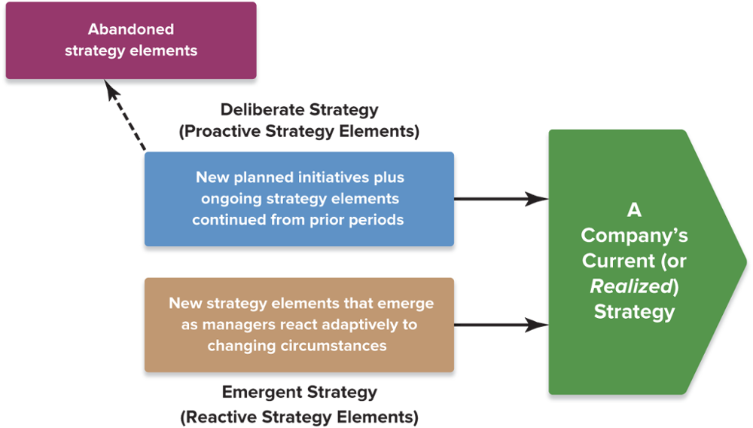
FIGURE 1.2 A Company’s Strategy Is a Blend of Proactive Initiatives and Reactive Adjustments
Jump to Appendix 3 long image description

Slide 21
THINKING STRATEGICALLY (1 of 2)
Just for Fun
Using the terms shown in Figure 1.2, explain why U.S. football teams get four downs to make a first down.
How does risk affect play selection (reactive strategy) as a team fails to advance on each of its four downs?
What rules of play in other sports affect how the basic principles of strategy are applied to game play?

Slide 22
A FIRM’S STRATEGY AND ITS BUSINESS MODEL
How the firm will make money:
By providing customers with value
The firm’s customer value proposition
By generating revenues sufficient to cover costs and produce attractive profits
The firm’s profit formula
It takes a proven business model—one that yields appealing profitability—to demonstrate viability of a firm’s strategy.

Slide 23
THE RELATIONSHIP BETWEEN A FIRM’S STRATEGY AND ITS BUSINESS MODEL
Realized Strategy
Competitive Initiatives
Business Approaches
Business Model
Value Proposition
Profit Formula
$$$?

Slide 24
CORE CONCEPT (4 of 4)
A firm’s business model sets forth the logic for how its strategy will create value for customers, while at the same time generate revenues sufficient to cover costs and realize a profit.

Slide 25
BUSINESS MODEL ELEMENTS: The Customer Value Proposition
The customer value proposition
Satisfying buyer wants and needs at a price customers will consider a good value
The greater the value provided (V) and the lower the price (P), the more attractive the value proposition is to customers

Slide 26
BUSINESS MODEL ELEMENTS: The Profit Formula
The profit formula
Creating a cost structure that allows for acceptable profits, given that pricing is tied to the customer value proposition
V – the value provided to customers
P – the price charged to customers
C – the firm’s costs
The lower the costs (C) for a given customer value proposition (V–P), the greater the ability of the business model to be a moneymaker.

Slide 27
THINKING STRATEGICALLY (2 of 2)
Amazon has begun to acquire its own fleet of cargo planes to deliver packages to customers.
What internal and external factors are contributing to this change in its strategy?
How could the move be explained in terms of changes in the value, price, and cost factors associated with Amazon's business model?
How does the forward integration entry of Amazon into the freight delivery markets in which FedEx and United Parcel Service compete affect the sustainability of their business models over the long term?

Slide 28
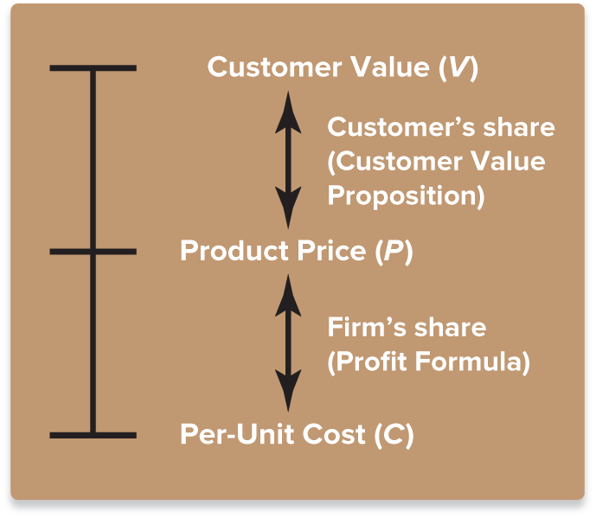
FIGURE 1.3 The Business Model and the Value-Price-Cost Framework
Jump to Appendix 4 long image description

Slide 29
IS OUR STRATEGY A WINNER?
The Fit Test
Three Tests of a Winning Strategy
The Competitive Advantage Test
The Performance Test

Slide 30
WHAT MAKES A STRATEGY A WINNER?
A winning strategy must pass three tests:
The fit test
Does it exhibit fit with the external and internal aspects of the firm’s dynamic situation?
The competitive advantage test
Does it help the firm achieve a sustainable competitive advantage?
The performance test
Will it produce superior performance as indicated by the firm’s profitability, financial and competitive strengths, and market share?

Slide 31
Pandora, Sirius XM, and Broadcast Radio: Three Contrasting Business Models
Who listens to the radio anymore?
How sustainable are the business models of Pandora, Sirius XM and over-the-air broadcasters over the long term?
Given the changes in user listening habits, which competitor’s present strategy best passes the three tests of a winning strategy?
What internal and external factors will create particular difficulties for each competitor in changing its strategy or business model?

Slide 32
WHY CRAFTING AND EXECUTING STRATEGY ARE IMPORTANT TASKS
Strategy provides:
A prescription for doing business
A road map to competitive advantage
A game plan for pleasing customers
A formula for attaining long-term standout marketplace performance
Good Strategy + Good Strategy Execution = Good Management

Slide 33
STRATEGIC MANAGEMENT PRINCIPLE (3 of 3)
How well a company performs is directly attributable to the caliber of its strategy and the proficiency with which the strategy is executed.

Slide 34
THINKING STRATEGICALLY (3 of 3)
Google’s browser-based Chrome operating system and its online applications suite are now challenging Microsoft’s long-term dominance of those marketplace sectors.
What should be Microsoft’s near-term response to this competitive challenge?
How will Microsoft’s long-term response to this competitor’s actions affect its business model?
Which competitor’s strategy will likely be the eventual winner in the marketplace? Why?

Slide 35
THE ROAD AHEAD
Strategy is about asking the right questions.
What must managers do, and do well, to make a firm a winner in the marketplace?
Strategy requires getting the right answers.
Good strategic thinking and good management of the strategy-making, strategy-executing process
First-rate capabilities and skills in crafting and executing strategy are essential to managing successfully
Welcome and best wishes for your success!

Slide 36
Appendix 1 Figure 1.1 Identifying a Firm’s Strategy–What to Look For
The actions to look for would be:
Strengthening of its bargaining position with suppliers, distributors, and others
Gaining sales and market share via more performance features, more appealing design, better quality or customer service, wider product selection, or other such actions
Gains in sales and market share with lower prices based on lower costs
Entering into or exiting from new or existing product lines or geographic markets
Using new approaches in managing R&D, production, sales and marketing, finance, and other key activities
Upgrading, building, or acquiring competitively important resources and capabilities
Capturing emerging market opportunities and defending against external threats to the firm’s business prospects
Strengthening market standing and competitiveness by acquiring or merging with other firms
Strengthening competitiveness via strategic alliances and collaborative partnerships
Return to slide

Slide 37
Appendix 2 Basic Strategic Approaches
Strategies for building competitive advantage include:
Low-cost provider
Focused low-cost
Best-cost provider
Focused differentiation
Broad differentiation
Return to slide

Slide 38
Appendix 3 Figure 1.2 A Company’s Strategy Is a Blend of Proactive Initiatives and Reactive Adjustments
Deliberative strategy (or proactive strategy elements) includes new planned initiatives plus ongoing strategy elements continued from prior periods.
Emergent strategy (or reactive strategy elements) includes new strategy elements that emerge as managers react adaptively to changing circumstances.
Both of these result in a firm's current (or realized) strategy.
Prior strategy elements may also be abandoned.
Return to slide

Slide 39
Appendix 4 Figure 1.3 The Business Model and the Value-Price-Cost Framework
Customer value (V) is the customer's share (customer value proposition). This value may affect or be affected by product price (P) which is the firm's share (profit formula). These values in turn affect and are affected by the per-unit cost (C).
Return to slide

